Slide 1
Decentralized Land Ownership System Using Blockchain
Presented by:
Isha Kandel [21070514]
Dipen Raut [21070510]
Kshitiz Gupta[21070516]
Utsab Wagle [21070545]

Slide 2





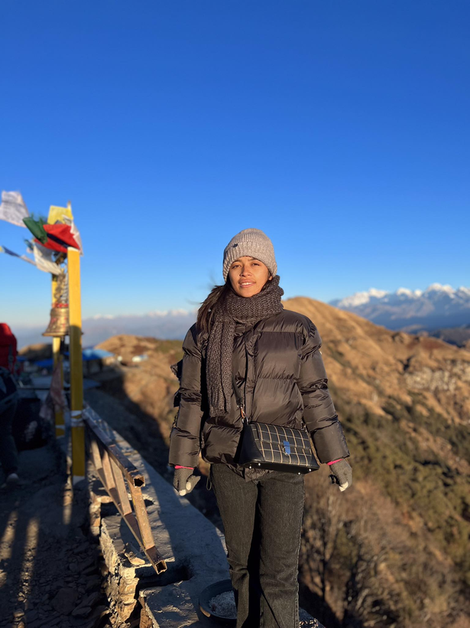
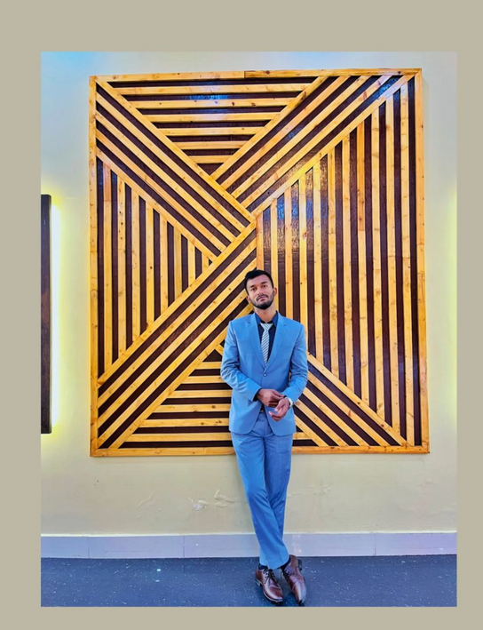



MEET OUR TEAM
Dipen Raut
Isha Kandel
Kshitiz Gupta
Utsab Wagle
DLOSUB

Slide 3
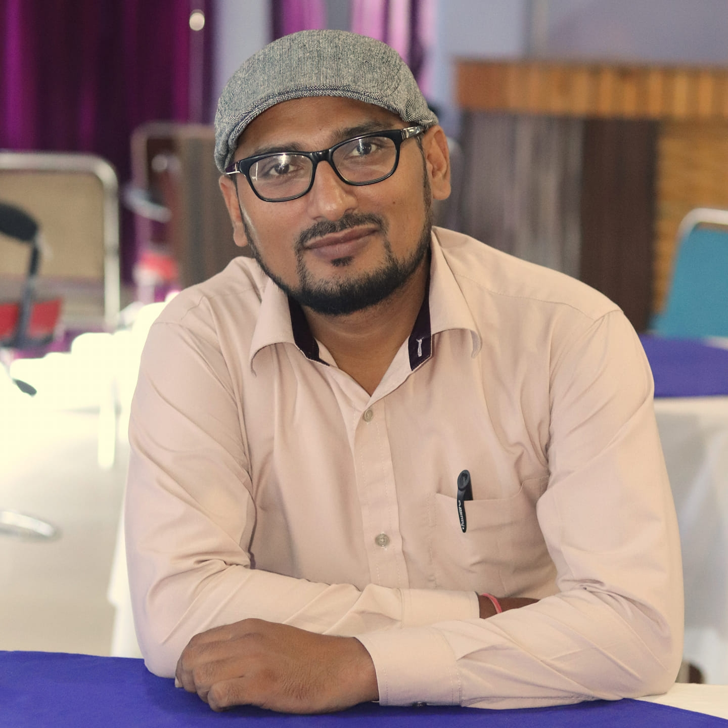
In Grateful Appreciation to Our Supervisor
Er. Mod Nath Acharya
Assistant Professor
United Technical College
“As our supervisor, your mentorship, patience, and encouragement were the driving force behind our project’s success. Thank you!”

Slide 4
CONTENT
01
INTRODUCTION
06
CASE STUDY
PROBLEM OF STATEMENT
02
07
METHODOLOGY
PROJECT OBJECTIVES
03
08
OUTCOMES
04
APPLICATIONS
09
FUTURE ENHANCEMENTS
05
LIMITATIONS
10
TIME AND COST ESTIMATION
REFERENCES
11

Slide 5
INTRODUCTION
Traditional land registries face inefficiencies and corruption, while a decentralized system offers accurate and accessible ownership data.
A
Blockchain ensures secure and transparent land ownership records, minimizing fraud and disputes.
B
DLOSUB

Slide 6
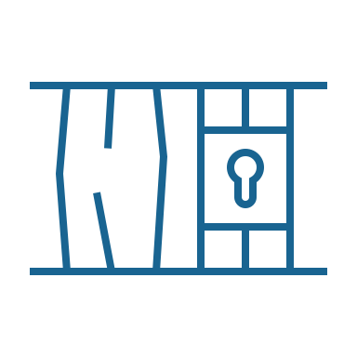


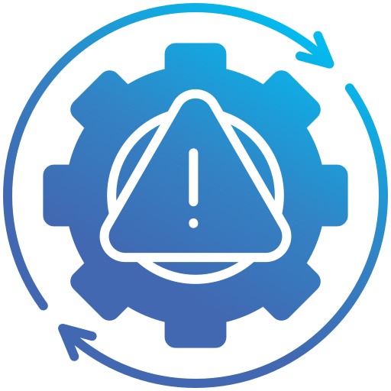
Problem Statement
Lack of Transparency and Accessibility
Existing land registries frequently lack transparency, making it difficult for individuals to verify ownership and access land records, which can lead to disputes and mistrust among stakeholders.
Fraud and Manipulation
Traditional land registration systems are vulnerable to fraudulent activities, including document forgery and unauthorized alterations of ownership records.
High Transaction Costs
The involvement of intermediaries, such as brokers and notaries, increases transaction costs and complicates the land transfer process, making it less accessible for individuals, especially those from marginalized communities.
Inefficiencies in Registration Process
The way products move lacks strong checks, making it easier for fake goods to spread, risking safety and brand trust.

Slide 7
Project Objectives
Elimination of Duplicate Claims
Transparency and Immutability
To eliminate duplicate claims and ensure secure ownership with cryptographic authentication
To provide tamper-proof and publicly verifiable land ownership records using blockchain.

Slide 8
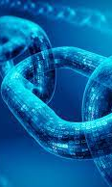
Applications
Transparent Land Registry
Provides a secure and tamper-proof platform for managing land ownership records, reducing disputes and fraud.
Automated Transactions
Uses smart contracts to streamline property transactions, eliminating intermediaries and cutting costs.
Efficient Tax Collection
Enables accurate real-time calculation and collection of taxes and fees, minimizing evasion and errors.
Disaster Resilience
Ensures land records remain accessible and intact through decentralized storage, even during disasters or cyberattacks.

Slide 9
Limitations
Geographical Challenges
The initial implementation will focus on specific regions, limiting applicability in areas with different legal frameworks.
High Initial Costs
Budget constraints may affect the scale and speed of implementation
Data Availability
The success of the project wholly relies on the accuracy of existing land records: incomplete data may pose challenges.
Resistance to Change
Resistance to adopt new technologies and methodologies and lack of digital literacy may limit user engagement

Slide 10
CASE
STUDY
Republic of Georgia Blockchain Land Registry
Georgia partnered with Bitfury to create a blockchain land registry, ensuring record authenticity and reduced costs. Despite its transparency, the system relies on centralized data for genesis blocks and struggles with scalability.
01
India’s Telangana Blockchain Pilot
Telangana’s blockchain pilot leveraged Ethereum for decentralized land records, offering tamper-proof storage and government integration. Challenges include scalability issues and bureaucratic hurdles.
02
DLOSUB
Sweden Land Registry (Lantmäteriet)
03
Ghana’s Bitland Project
Sweden’s Lantmäteriet used blockchain with smart contracts to automate land transactions and improve data integrity. However, the system faced high implementation costs and reliance on stakeholder collaboration.
Bitland developed a blockchain ledger for land transactions, benefiting underprivileged communities by reducing corruption. Its growth is limited by funding and infrastructure challenges.
04
05

Slide 11
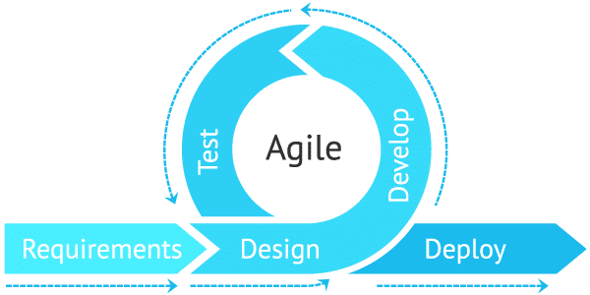
Methodology
Software Development Life Cycle

Slide 12
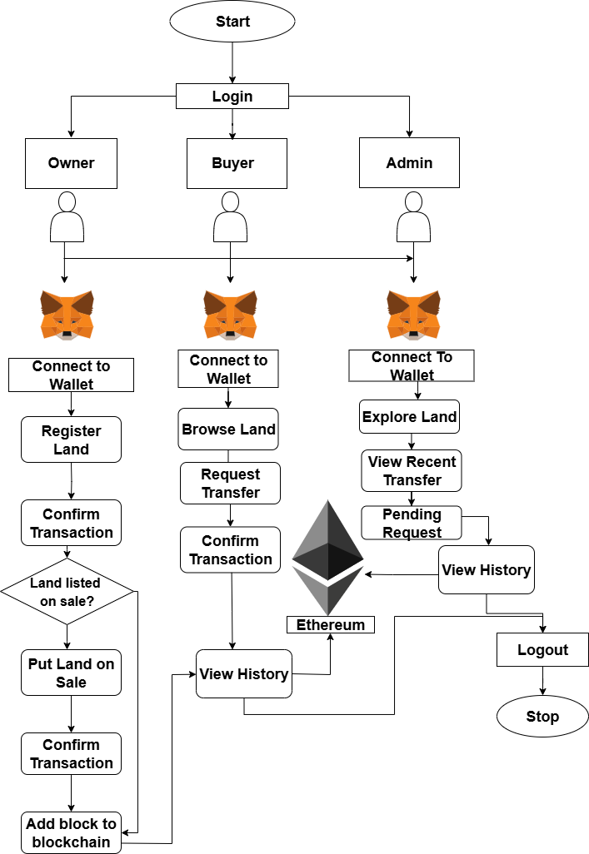
System Flow Diagram

Slide 13
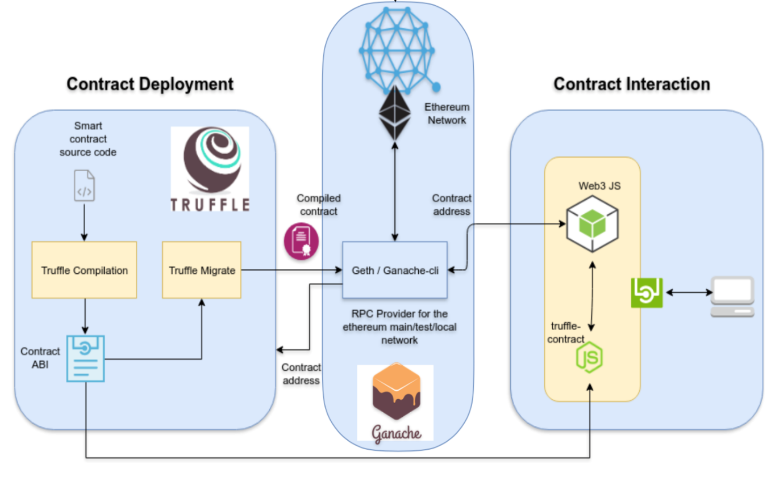
System Architecture

Slide 14
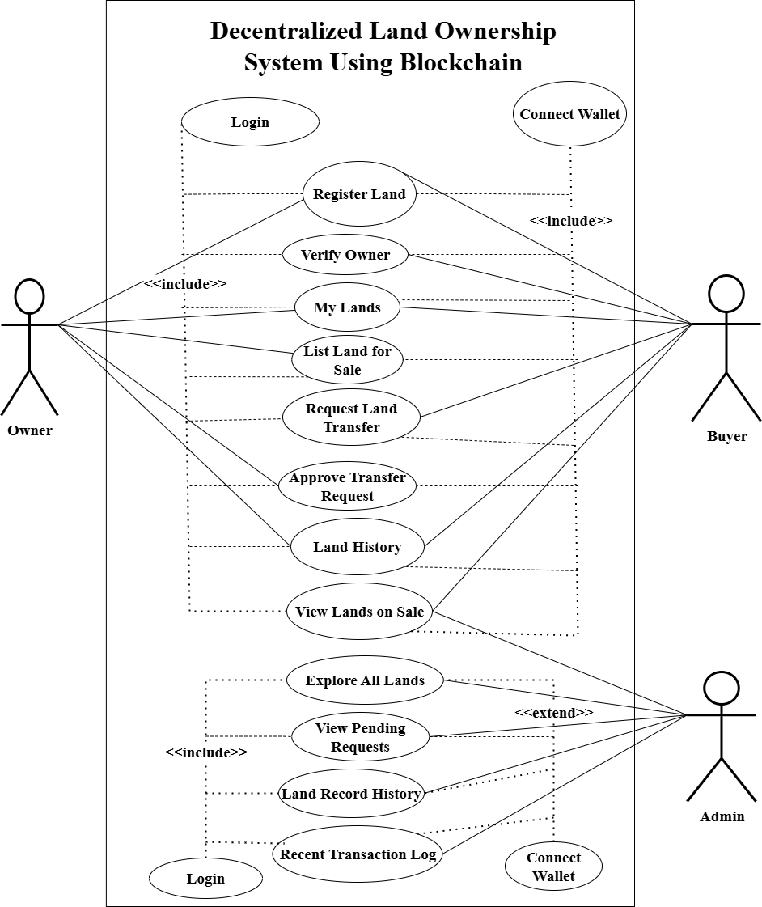
Use Case Diagram

Slide 15
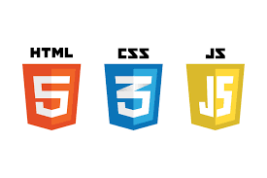
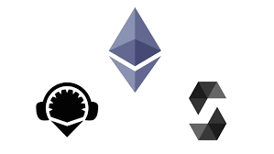


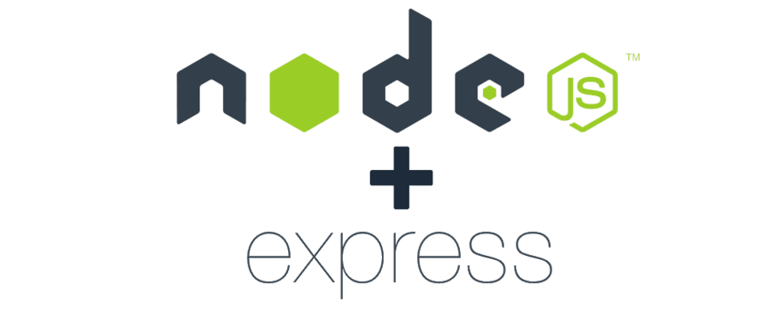
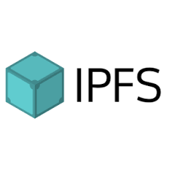
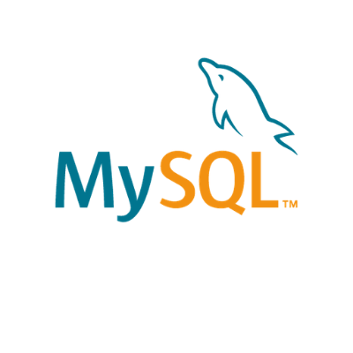
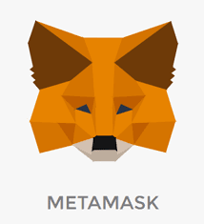



TOOLS AND TECHNOLOGIES USED

Slide 16
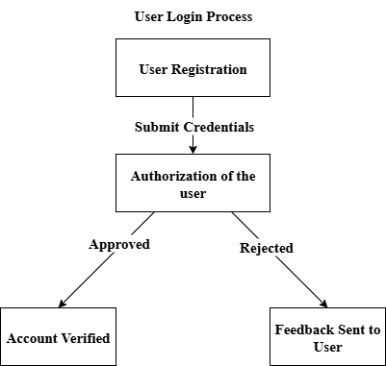
Registration Flow of System

Slide 17
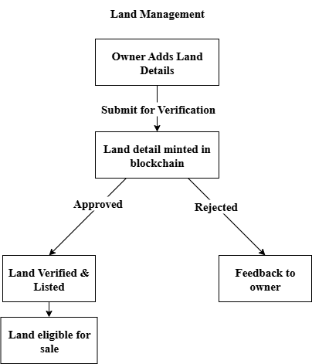
Verification of System

Slide 18
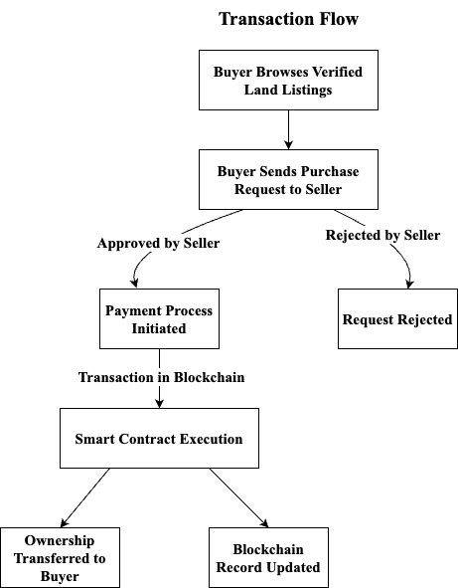
Transaction Flow of System

Slide 19
Outcomes
Tamper-Proof Land Records
The system will provide a secure, tamper-proof digital ledger for land ownership records.
Reduction in Fraudulent Claims
Streamlined Transaction Processes
The project aims to reduce fraudulent ownership claims assessed by monitoring reported disputes before and after implementation.
Smart contracts are expected to decrease transaction time.
Increased Accessibility
Users, including marginalized communities, will be able to access and verify land ownership records without intermediaries, evaluated through user surveys during pilot testing.

Slide 20
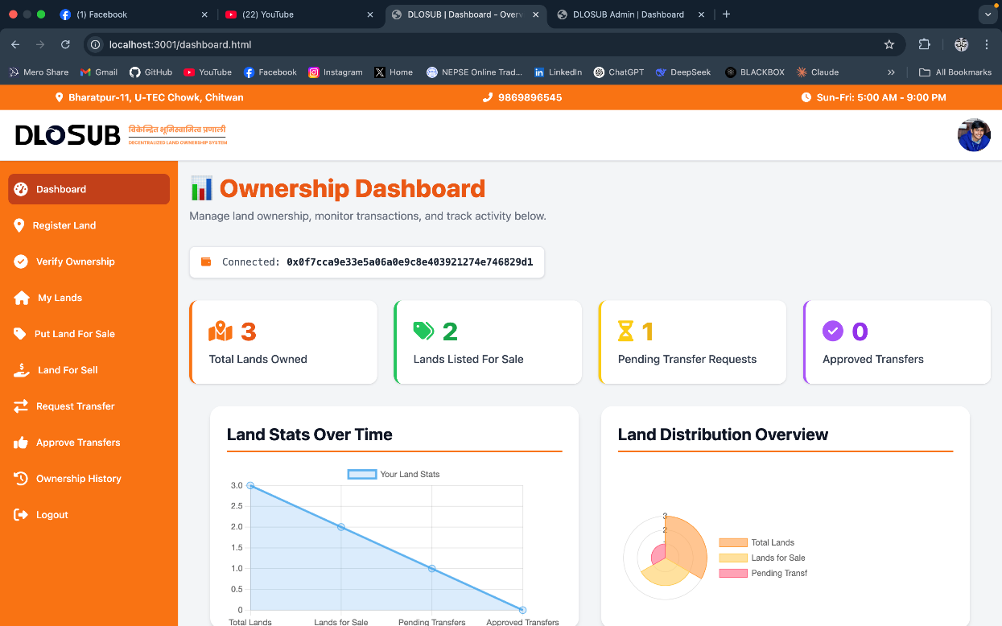
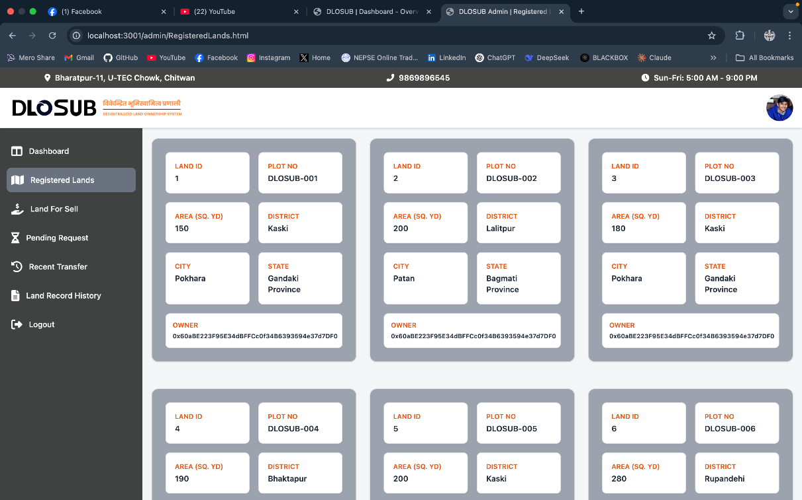
DLOSUB
Interface

Slide 21
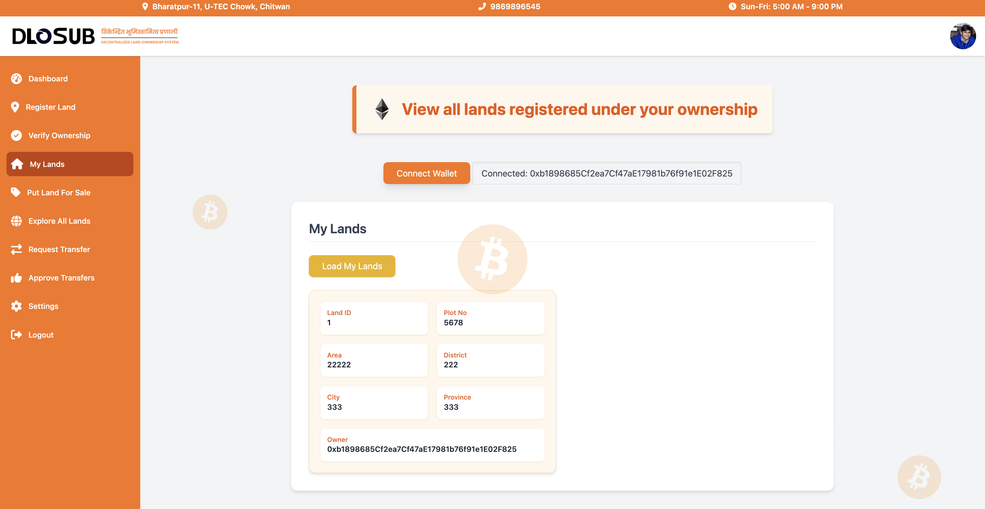
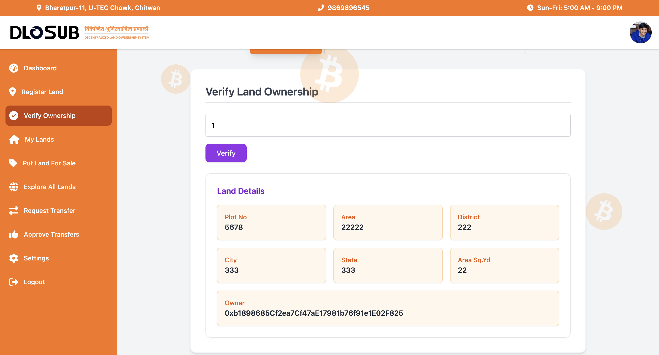
DLOSUB Interface

Slide 22
Future Enhancements
Interoperability with Other Blockchains: Enable cross-chain compatibility for greater flexibility.
Mobile Application Development: Develop iOS and Android apps for better accessibility.
Support for Additional Cryptocurrencies: Extend support to include additional cryptocurrencies for transaction payments and rewards.

Slide 23
Time Estimation

Slide 24
Cost Estimation
Cost Element | Estimated Cost Range (NPR)
Infrastructure and Hosting | NPR 5,000 – NPR 10,000
Testing and Quality Assurance | NPR 5,000 – NPR 10,000
Training and Documentation | NPR 5,000 – NPR 10,000
Maintenance and Support | NPR 10,000 – NPR 25,000

Slide 25
REFERENCES
[1] S. Gurbanov and F. Suleymanli, “Analytical Assessment of Green Digital Finance Progress in the Republic of Georgia,” in Economics, Law, and Institutions in Asia Pacific, Springer, 2022, pp. 205–222. doi: 10.1007/978-981-19-2662-4_10..
[2] J. Mcmurren, A. Young, and S. Verhulst, “B LO C KC H A N G E Addressing Transaction Costs Through Blockchain and Identity in Swedish Land Transfers.”
[3] S. Pandey and C. Sen, “Blockchain Technology in Real-Time Governance: An Indian Scenario,” Indian Journal of Public Administration, vol. 68, no. 3, pp. 397–413, Sep. 2022, doi: 10.1177/00195561221105241.
[4] B. Lundstrøm Olsen -66937, “BEYOND THE HYPE: EXPLORING BLOCKCHAIN TECHNOLOGY IN LAND ADMINISTRATION A case study of Ghana and property rights,” 2018.

Slide 26
THANK YOU
DLOSUB

